Slide 1
Hidden Picture

Slide 2
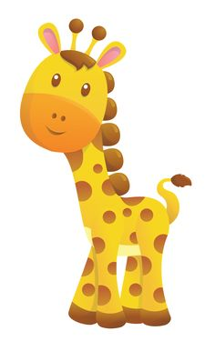
Remove

Slide 3
Remove

Slide 4
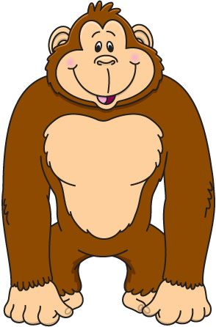
Remove

Slide 5
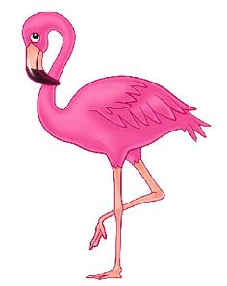
Remove

Slide 6
Remove

Slide 7
Remove

Slide 8
Remove

Slide 9
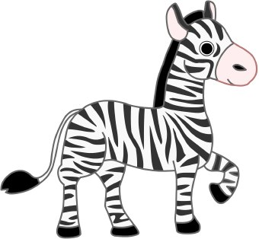
Remove

Slide 10
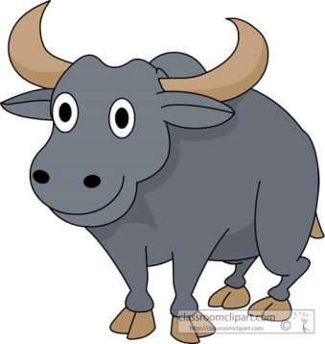
Remove

Slide 11
Remove

Slide 12
Game Over

